Slide 1
Final Project Presentation
EECE 2140 – Frank Anderson

Slide 2
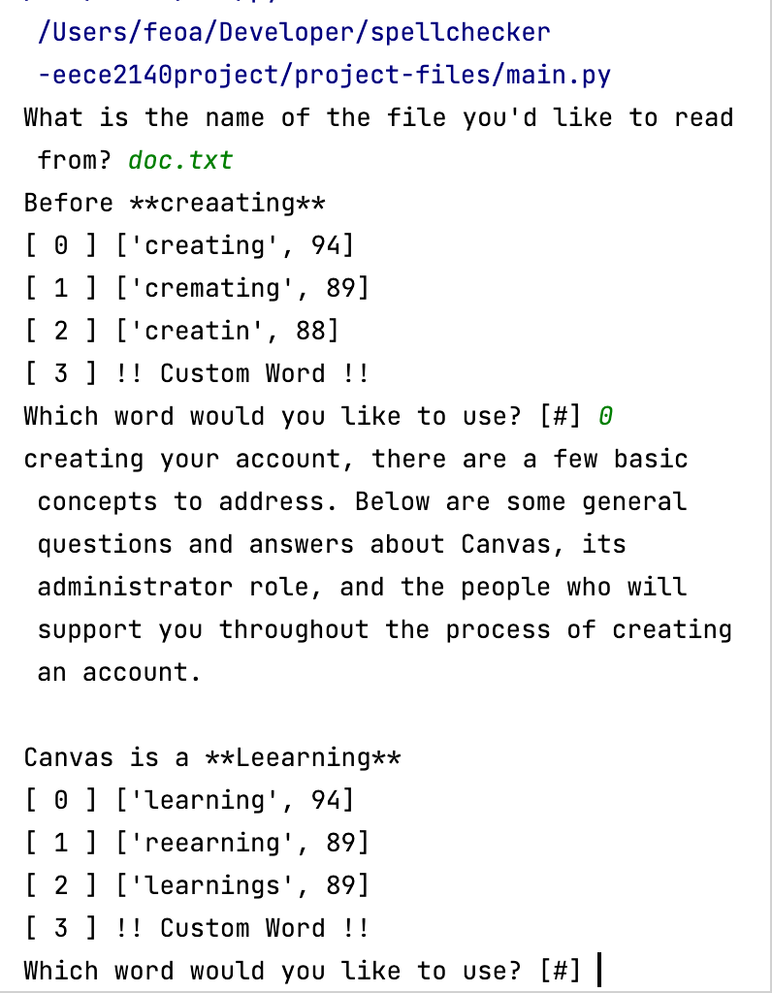
Overview & Main Features
Spell Checker application
Reads .txt file and finds spelling errors
Asks user to choose from a list of suggestions or use their own word
Writes changes to new .txt file.

Slide 3
Demo

Slide 4
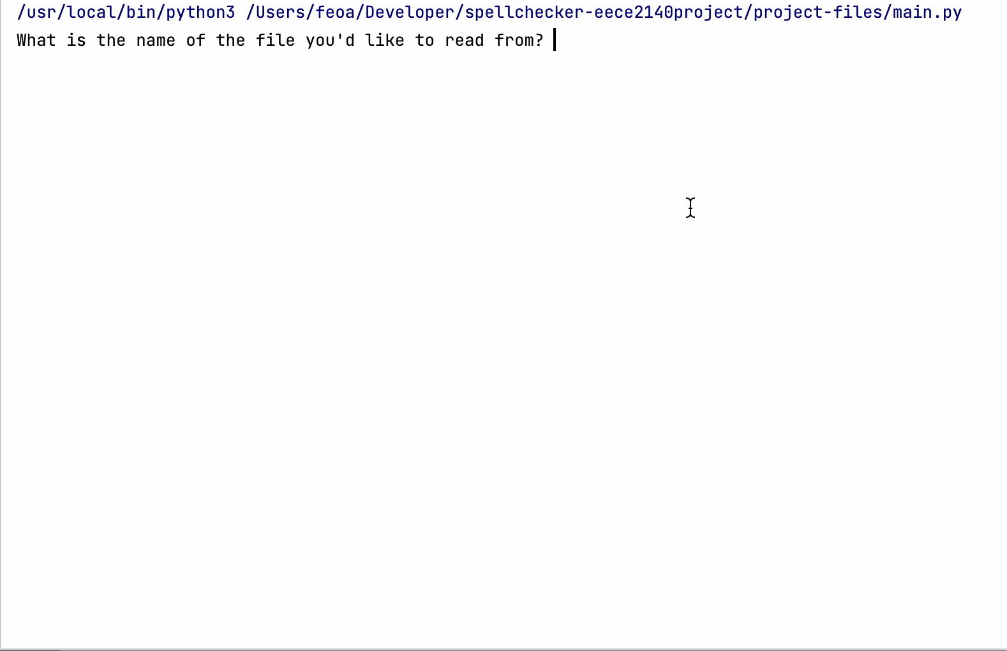
<TODO: Record video of different inputs and play>

Slide 5
Code Walkthrough
Classes and logic guide

Slide 6
Architecture
GrammarChecker
- print_options([string, int], string)
- get_choice([string, int], string)
- get_custom(string)
File Manager
Grammar Checker
Dictionary
FileManager
+ filename
- validate_filepath()
Dictionary
- data
+ find_similar(self, string)
+ clean_input(string)
+ word_in(self, string)
+ __init__()
- add_to_dictionary(string)

Slide 7
File Manager
Asks user for file to read
Validates the given file path is a valid file path
FileManager
+ filename
- validate_filepath()
Notes:
Filename makes the filename of the read/write file accessible in the GrammarChecker class.
Validate filepath asks user for a file and checks the path is valid before proceeding.

Slide 8
Grammar Checker
GrammarChecker
Main class for the Application
Analyzes file word by word using a buffer
Asks user for choice from suggestions
- print_options([string, int], string)
- get_choice([string, int], string)
- get_custom(string)
Didn’t use instance variables, since everything happens linearly in __init__
Notes:
Class where most of the logic takes place

Slide 9
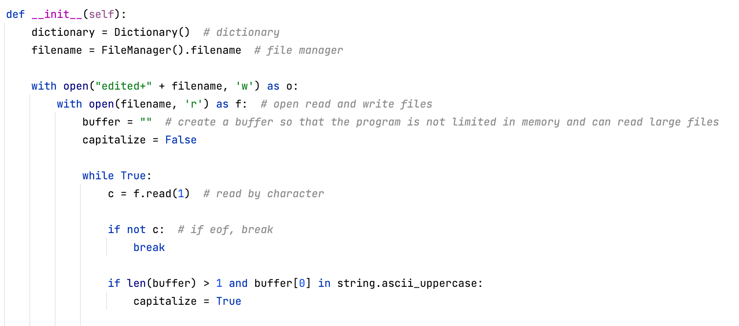

Slide 10
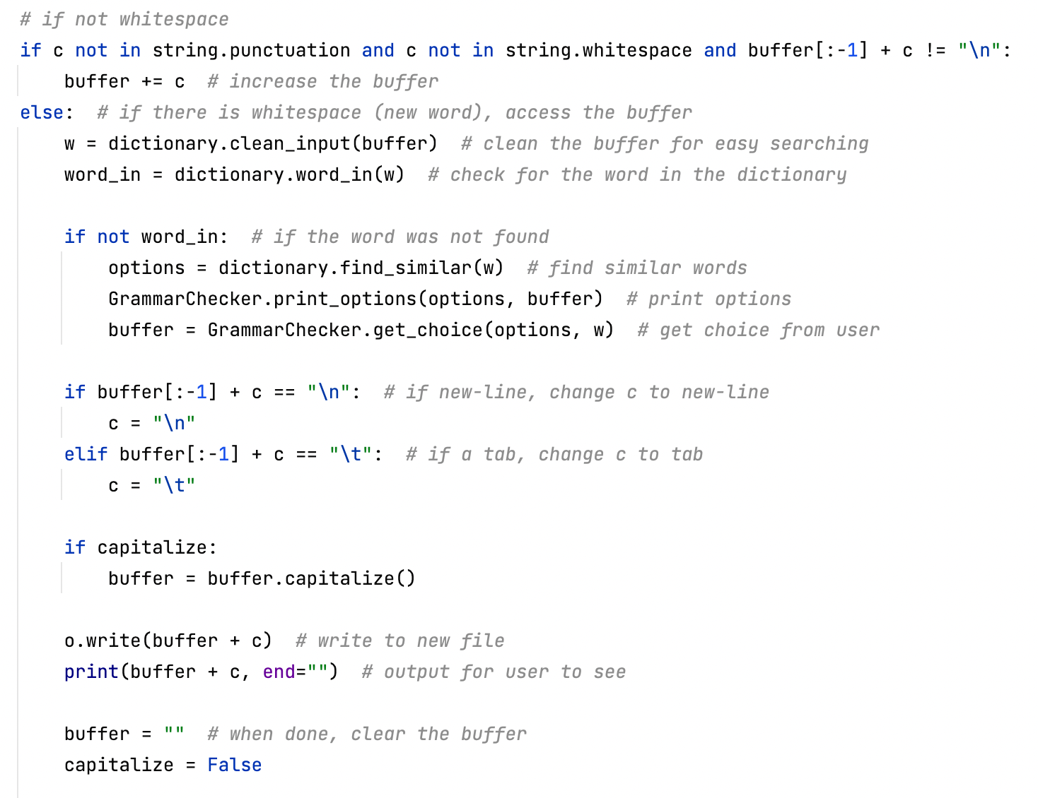

Slide 11
Grammar Checker Logic Walkthrough
Create instance of Dictionary and FileManager
Open file and create edited version
Read file word by word using a buffer
Track if the word starts with a capital
If the word is not punctuation or whitespace, proceed
Clean up the word to make searching easier
Check if the word is in the dictionary. If so, write to new file and keep moving
Otherwise, find similar words and ask user to pick one
Write choice to new file and move to next word

Slide 12
Dictionary
Dictionary
Loads dictionaries as plain text files with words separated by new lines
Cleans up inputs and stores words
Finds similar words when given a word
Can check if a word is in dictionary
- data
+ find_similar(self, string)
+ clean_input(string)
+ word_in(self, string)
+ __init__()
- add_to_dictionary(string)

Slide 13
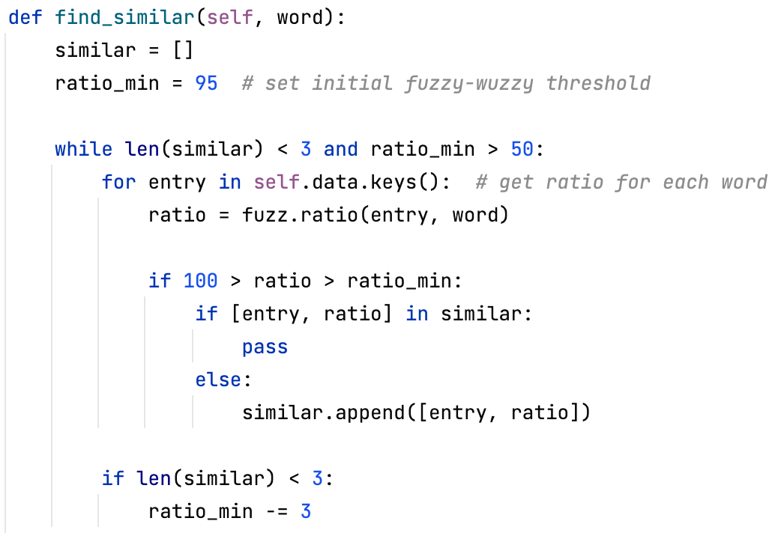
Finding Suggestions
String matching is hard!
Tried using score-based system where each word was given a score based on difference
Was ineffective, even after lots of tuning and limiting on what suggestions were valid
Instead used library developed by StubHub called FuzzyWuzzy
Compares two words and gives the difference a score.
Higher the score, more similar the words
Even their version is slow
… return similar

Slide 14
Thank You

